Slide 1
Todd Folse & Dione Milton
LHC Compliance & Asset Management

Slide 2


COMPLIANCE MONITORING
Mission of the Compliance Division
Ensure, through desk audits & on-site inspections, that property owners and managers adhere to Federal, State & local laws governing program administration and compliance
Operate low-income rental housing programs professionally and efficiently

Slide 3
ORGANIZATIONAL CHART
Housing Finance Manager
Construction Monitoring
Compliance Monitoring
Administrative
Building Plan Review
Compliance Reviews
Inspection
Regulatory Compliance
Training

Slide 4
Portfolio
Total Developments: 954 (consisting of 52,695 units) Funded With
Tax Credits – 850 (200 in Extended Use) | HOME – 242
CDBG Piggyback – 65 | 1602 – 44
FDIC – 11 | NSP – 8
ARP – 15 | 811 - 17

Slide 5
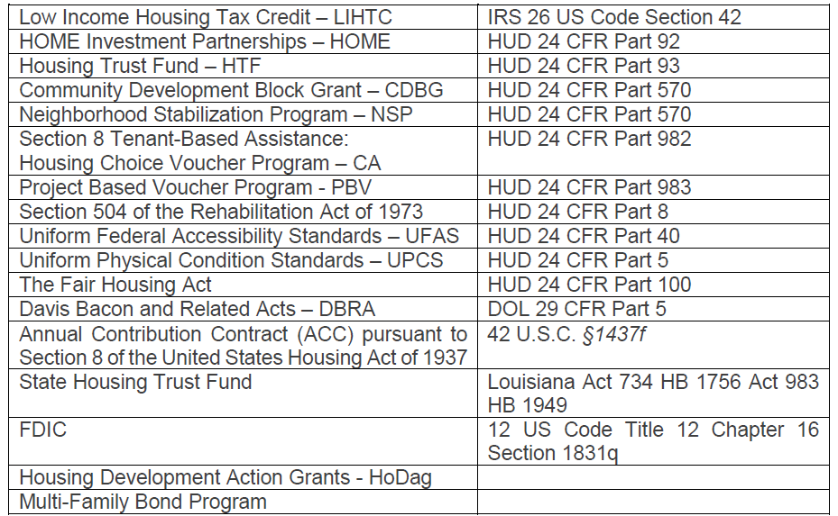
Funding Sources | Regulations

Slide 6
DUTIES & RESPONSIBILITES

Slide 7
Initiation of Compliance Monitoring
A property is transferred to the Compliance Department for monitoring when the Program (LIHTC, HOME, etc.) attaches regulatory documents to the property in Housing Development Software (HDS).
The Compliance Supervisor reviews the submission in order to determine whether all documentation necessary for the property to be added to the Compliance Department Portfolio has been attached in HDS.
The transfer becomes official after the documentation is reviewed by the Manager/Supervisor and stage tracking has been updated in LHC’s system of record.
4. Pertinent project information is entered into electronic data management …….systems, including but not limited to Housing Development Software ……(HDS), the Compliance Portfolio file, electronic data project folders ……. …….created under the Compliance folder on LHC’s V: drive, and other …….databases currently in use.
Responsibility for monitoring the project is then transferred to the assigned .Compliance Specialist who inserts the project into his or her schedule of .reviews.
Each project in the Compliance portfolio is assigned to a Compliance .Specialist each year, regardless of whether the project is to be reviewed .that year. Compliance Specialists are responsible for all activities relative .to their assigned properties.

Slide 8
Compliance Review Procedures
A Preliminary Desk Review of the applicable Regulatory Agreement and previous inspections.
An On-Site Physical Inspection of the common areas of the property and a sample of units, excluding those inspected during the last review, unless a follow-up inspection is needed on a particular unit.
An On-Site Occupancy Review of tenant files for eligibility and supporting documentation.

Slide 9
Scheduling Reviews
GEOGRAPHIC LOCATION
At least 3 projects in the same geographical area should be scheduled during a single week to maximize efficiency when scheduling project reviews which require overnight stays
At the beginning of the year, Compliance Specialists are assigned properties for which they will be responsible during that year and informed as to which properties require on-site reviews. Staff members construct work plans for each year under the guidance of management and subject to management approval.
Upon approval of work plans, staff members should implement reminder systems to prompt for key events and activities during the year.
Work plans are constructed according to the following guidelines:
NEW PROJECTS
Compliance personnel should make efforts to leave time available toward the end of the year to allow for the holiday season as well as a review of new projects
SIZE & NATURE OF PROJECT
The size of a project is the determining factor in how long it will take the complete the review. (Large projects may take more than 1 day to complete)
OFFICE TIME
Office time should be allowed in the work plan to ensure that all reporting, scheduling, and follow-up activities are completed in accordance with deadlines

Slide 10
Scheduling Reviews
Property owners and site managers should be notified of pending site visits in writing no more than 15 days in advance. The scheduling letter or email must inform the owner and site manager of the inclusive dates of the visit and should include a blank property information sheet for completion and submission by the owner.
The letter or email must also inform management of the need to notify tenants of the on-site review and request that the following documents be made available for review during the visit:
COPY OF CURRENT LEASE
COPY OF MOST RECENT RENT ROLL
COPY OF CURRENT WAITING LIST
BLANK APPLICATION FORM
SCHEDULE II-A(UNIT STATUS REPORT) FOR MONTH PRIOR TO THE INSPECTION
UPDATED INFORMATION SHEET INDICATING CURRENT CONTACT INFO FOR THE OWNER, MANAGEMENT AGENT & SITE MANAGER

Slide 11
STATISTICS

Slide 12
2019 Statistics | Construction
2016 Flood 59
HQS 202
SRPP 172
Tax Credit & HOME 155
UPCS V 1,099

Slide 13
2019 Statistics | Compliance
Building Inspections
4,851
Unit Inspections
3,971
Properties 349
Tax Credit 287
HOME 147
Piggyback 39
1602 34
FDIC 10
NSP 2
ARP 8

Slide 14
2019 Statistics | Management Occupancy Reviews
The Construction and Compliance Monitoring department partners with the PBCA department to perform Management and Occupancy Reviews (MORs) onsite at the properties requested by the PBCA team and HUD on a quarterly and annual basis.
The purpose of these reviews is to identify and resolve areas of noncompliance with HUD regulations and other requirements at rental units with Section 8 contracts.
MOR 79
Total Gross Revenue
$291,800.00

Slide 15
ASSET
MANAGEMENT
Mission of the Asset Management Division
Responsible for the fiscal oversight of LHC-funded and owned multi-family projects
Monitors and enforces regulatory requirements to preserve project viability and affordability of the projects in the LHC’s multi-family Asset Management portfolio

Slide 16
ORGANIZATIONAL CHART
Compliance Examiner Manager
Compliance Examiner
Compliance Examiner
Compliance Examiner Manager
Construction Monitoring
Administrative
Compliance Reviews
Inspection
Regulatory Compliance
Training

Slide 17
Asset Management Functions
Annual Desk Monitoring Reviews
Year 15 Request
Loan Servicing
Home Investment Partnership Program – Multi-Family Rental Loans
Neighborhood Stabilization Program – Multi-Family Rental Loans
Housing Trust Fund – Multi-Family Rental Loans
Transfer of Ownership / GP Changes
Qualified Contract
Low-Income Housing Tax Credit Program “LIHTC”
Multi-Family Rental Loan Subordination Request/ Reviews
Tax Credit Assistance Program “TCAP”
Tax Credit Exchange Program – “1602”
Home Investment Partnership Program “HOME”
Federal Depository Insurance Company “FDIC” / RTC
Neighborhood Stabilization Program “NSP”
Housing Trust Fund “HTF”
Community Development Housing Block Grant Program “CDBG”

Slide 18
Governing Documents
Federal Regulations
Funding Notices
  Qualified Allocation Plan (QAP)
  Notice of Funding Availability (NOFA)
Regulatory Agreements
Compliance Monitoring Agreements
Promissory Notes / Mortgages
Compliance Reviews

Slide 19
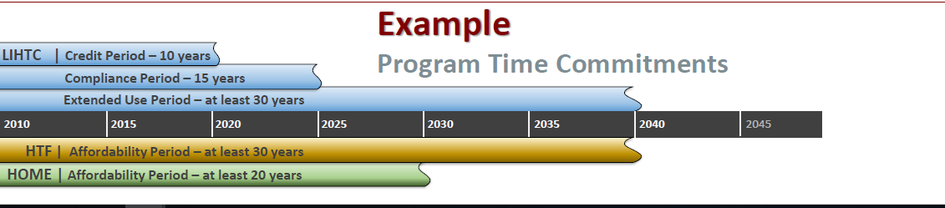
Affordability Commitments
Compliance Reviews

Slide 20
Non-Compliance
Notification Provided to Owner
Include list of non-compliant issues
Provide Period to Cure
Reporting to IRS (LIHTC / 1602 Exchange)
Issuance of 8823
During the 15 Year Compliance Period
Tax Credit Recapture
Disqualification of Future Participation / Loss of Future Funding in LHC Programs

Slide 21


(225) 763-8700 • LHC.LA.GOV

