Slide 1
Quarterly Update
Louisiana Housing Corporation
FY 2019

Slide 2

LHC Strategic Goals
Meet affordable housing and community needs by increasing and preserving housing opportunities for the people of Louisiana
Optimize organizational resource
Forge and Strengthen partnerships by developing multi-faceted outreach efforts designed to assess needs by empowering communities to address their priorities

Slide 3

Production Reports
2nd Quarter Dollars invested in the Community
Rental Assistance
  $31.3 million payments
  17,586 families assisted
Homeless Solutions and Services
  $3.4 million released
  3,358 families assisted
Energy Assistance and Weatherization
  $9.8 payments
  19,523 families assisted
Single Family Loans
  $22.1 million released
  151 families assisted
Housing Development
  $11.4 million released
  24 developments

Slide 4
2nd Quarter Highlights
40,467 families receiving direct benefits from LHC
$11.4 million disbursed to nonprofits and for-profit developers
LHC Executive Director appointed to FHLB of Dallas Advisory Board
LHC homeowner production increased 15% Oct-Dec 2018
Strengthened partnerships through Community Connections approach

Slide 5

3rd and 4th quarter
$25 Million Katrina/Rita NOFA Piggyback
$6 Million Lafourche Resiliency NOFA
LHC Housing Conference
2019 QAP
More opportunities from the Division to fund housing

Slide 6
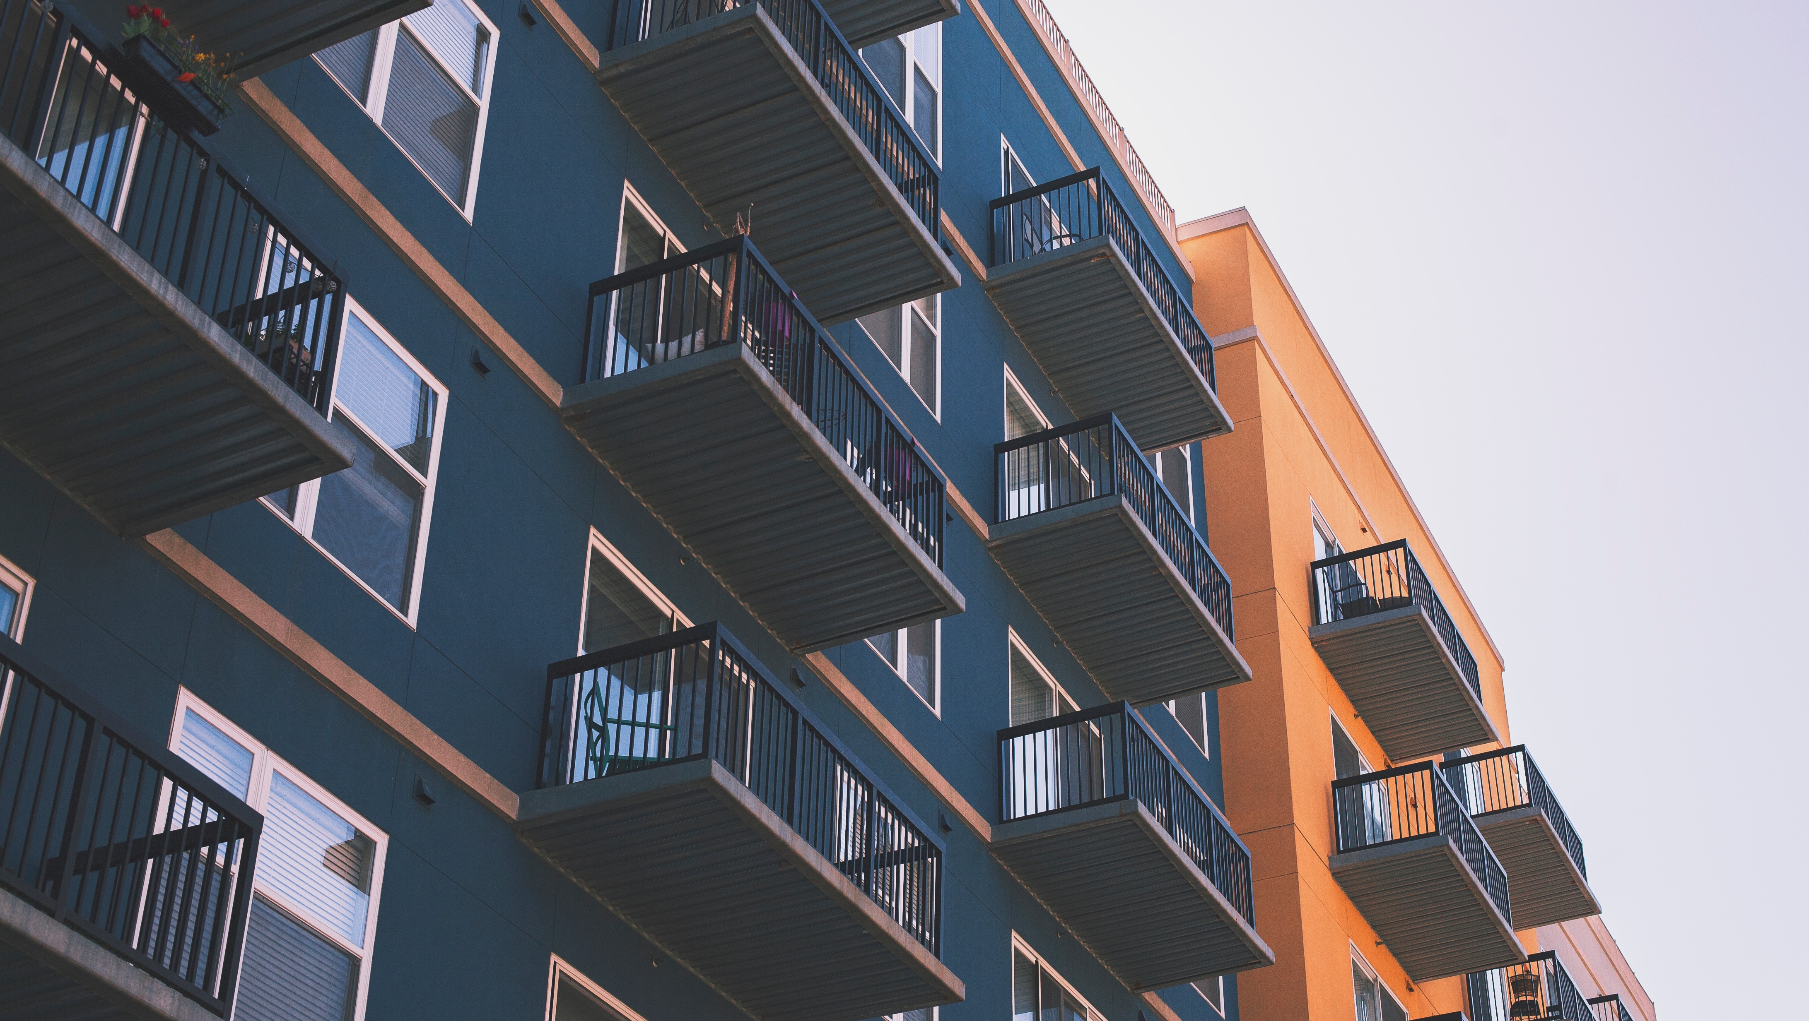

(225) 763-8700 • LHC.LA.GOV

