Slide 1
Continuum of Care (CoC) Program
at the Louisiana Housing Corporation
Presenter: Gordon Levine, Continuum of Care Manager

Slide 2
What is the CoC Program?
The largest competitive grant funding source in HUD (and the entire federal government): it funds $2.2 billion annually in housing and supportive services for people experiencing homelessness
The largest funding source dedicated to homelessness in Louisiana: in 2019, it funded nearly $55 million, at least double all other homeless-dedicated sources combined
In exchange for CoC Program funding, HUD requires organizations and communities to work together to prevent and end homelessness
That coalition of stakeholders is called a Continuum of Care (CoC)

Slide 3
What does the CoC Program fund?
Rapid Re-Housing (RRH): short- to medium-term (3-24 month) scattered site rental vouchers, case management, and supportive services for people experiencing homelessness (on the streets, in a shelter, or fleeing domestic violence)
Permanent Supportive Housing (PSH): long term (unlimited duration) single-site housing or scattered site rental vouchers, case management, and supportive services for people experiencing chronic homelessness (12+ months AND a severe and persistent physical or mental disability)
Planning Costs and HMIS: lead agencies only: the costs of building and maintaining the coalition, submitting the collaborative application, maintaining and reporting on homelessness data, issues advocacy, education, etc.

Slide 4
The CoC Program in Louisiana
Seven (7) CoCs in Louisiana
Five (5) are smaller regional CoCs that receive ~$1 million annually
The Jefferson/Orleans CoC is one of the largest in the US; it receives ~$22 million annually
The Louisiana Balance of State Continuum of Care (LA BOSCOC) covers approximately half the state, including Baton Rouge, Lake Charles, and Houma-Terrebonne, and receives ~$19 million annually
LHC is the collaborative applicant (“lead agency”) for the LA BOSCOC

Slide 5
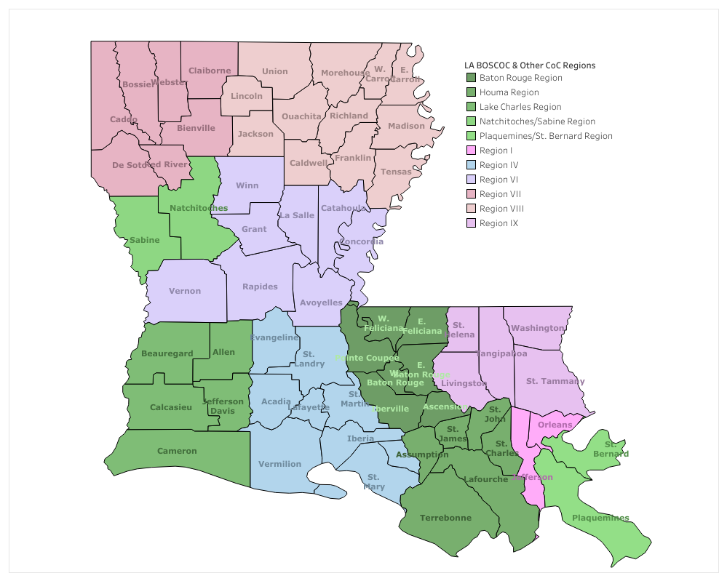
Continuums of Care in Louisiana - Map

Slide 6
Continuums of Care in Louisiana

Slide 7
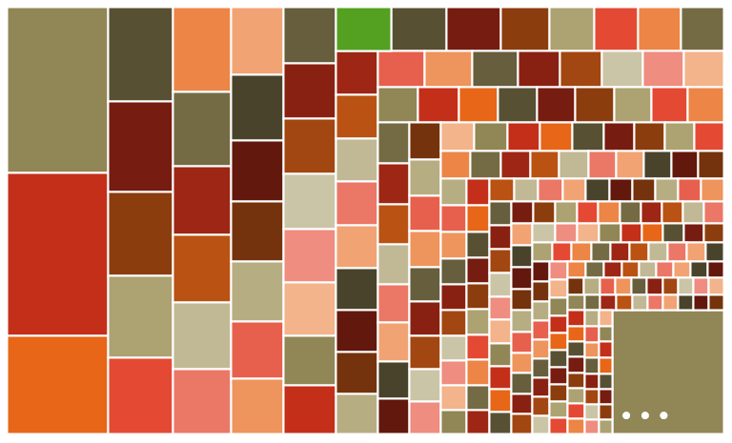
Continuums of Care - Nationally
This is the LA BOSCOC. We receive the 30th largest award…
…out of ~400 total CoCs. (Here are ~300 of the smaller ones.)

Slide 8
The CoC Program in Louisiana
Seven (7) CoCs in Louisiana
Five (5) are smaller regional CoCs that receive ~$1 million annually
The Jefferson/Orleans CoC is one of the largest in the US; it receives ~$22 million annually
The Louisiana Balance of State Continuum of Care (LA BOSCOC) covers approximately half the state, including Baton Rouge, Lake Charles, and Houma-Terrebonne, and receives ~$19 million annually
LHC is the collaborative applicant (“lead agency”) for the LA BOSCOC

Slide 9
The CoC Program at LHC
LHC has two separate roles in the CoC Program:
(both roles are played by the Department of Housing and Homeless Sevices)
PROJECT RECIPIENT/
FUND ADMINISTRATOR
LEAD AGENCY/
COLLABORATIVE APPLLICANT

Slide 10
Project Recipient/Fund Administrator
Apply for and receive money directly from HUD
Pass money to subrecipients who implement housing and case management
Monitor subrecipient spending and compliance; report annually to HUD
As a recipient/funder, LHC was awarded approximately $14 million for FY 2020
NOTABLE PROJECT: the LAPSH project (~$12 million annually) is a legacy project awarded in the wake of Katrina/Rita; it is the largest homeless-dedicated housing project in Louisiana and provides PSH statewide (majority is in New Orleans)

Slide 11
Lead Agency/Collaborative Applicant
Submit collaborative application for the LA BOSCOC to HUD – includes LHC funding but also all other organizations’ funding requests
Provide monitoring, technical assistance, expert knowledge
Conduct annual activities like the Point in Time (PIT) Count
Report to HUD and to other stakeholders (governor, local governments)
CoC staff are unusual; we don’t do services; we are more like technical assistance providers, policy-makers, and advocates; we often function like TA providers or consultants
CoC Planning Grant and HMIS grant combined are nearly ~$1 million, but they can only be spent on coalition-building, -assessment, and –reporting activities in the LA BOSCOC; mostly, that means staff salaries

Slide 12
How to access services
HUD requires every CoC to operate a Coordinated Entry System – a collaborative network that ensures a person can access all the services in their area by going to an Access Point
Every access point in Louisiana is listed at www.LABOSCOC.org under the Housing and Services link
A person can go to that website and navigate by:
Clicking on their parish
Selecting their parish by name
Searching by city
In many areas, you can also call 211. In Baton Rouge, you can call the One Stop at 225-388-5800 or St. Vincent de Paul at 225-383-7343.

Slide 13
Homelessness in Louisiana
In general:
Between 2011 and 2019, homelessness in Louisiana decreased 69%
However, almost no gains were made 2017-2019, and homelessness increased between 2019 and 2020 (before COVID-19)
Why? Outside factors (employment, affordable housing) and funding availability (limited new funding means limited new vouchers – and since PSH is unlimited duration…)
During COVID-19:
CoC staff have contributed significantly to placing nearly 1,500 people in non-congregate shelter who would otherwise have been deeply vulnerable to COVID-19
Non-congregate shelter is transitioning to permanent housing ASAP

Slide 14
Questions?
You can also email questions, including inquiries about assistance, to Gordon Levine, Continuum of Care Manager, at glevine@lhc.la.gov

