Slide 1

State of Louisiana’s U.S. Treasury
Emergency Rental Assistance Program
Overview and Update for LHC Board of Directors

Slide 2
State of Louisiana’s Emergency Rental Assistance Program
In January 2021, The U.S. Treasury provided $161 million in additional funding to Louisiana for emergency rental assistance to help meet the needs of renters and landlords impacted by the COVID-19 pandemic.
The State program is serving 57 parishes, with seven parishes administering their own programs.
CADDO
JEFFERSON
Renters residing in these seven parishes are encouraged to contact their local representatives or may visit LAStateRent.com to learn more about how to contact their parish-specific programs directly.
CALCASIEU
LAFAYETTE
EAST BATON ROUGE
ORLEANS
ST. TAMMANY

Slide 3
Application Process
Program Objectives
Keep people housed during the pandemic by preventing evictions for failure to pay rent
Serve the maximum number of households as quickly as possible while prioritizing those in greatest need
Prioritize applicants who previously applied to the Louisiana Emergency Rental Assistance Program (LERAP)
Ensure equitable geographic distribution of assistance
Compensate landlords for unpaid rent during COVID-19 eviction moratoria
To apply, visit LAStateRent.com.
To receive the fastest assistance, applicants are strongly encouraged to apply online. Assistance with the online application is available
by phone at 877.459.6555
Monday – Friday, 8 a.m. to 5 p.m.
An application may be initiated by either tenant or landlord, but information and documentation will be collected from both parties.
Landlords are strongly encouraged to participate to ensure that they are paid for past-due rent in a timely manner.

Slide 4
Assistance and Eligibility
Eligible households may receive up to 12 months of assistance for past-due rent, plus an additional three months in forward rental assistance to ensure housing stability.
Landlords must agree to forgive late fees, penalties and interest, not charge for court costs and commit not to evict tenant for past-due rent prior to April 2020 and for at least 60 days after assistance ends unless eviction is for cause other than non-payment of rent.
RENTER ELIGIBILITY REQUIREMENTS
LANDLORD ELIGIBILITY REQUIREMENTS
Live within one of the 57 parishes served by the program and provide the following:
Must agree to program terms and conditions and provide the following:
INCOME DOCUMENTATION ≤80% of area median income
DEMONSTRATION OF HOUSING INSTABILITY OR RISK OF HOMELESSNESS
DEMONSTRATION OF FINANCIAL HARDSHIP DUE TO COVID-19
PROOF OF AUTHORITY TO RENT PROPERTY
TAXPAYER ID
IDENTITY VERIFICATION
LEASE DOCUMENTATION

Slide 5
Operational Metrics
PIPELINE STATUS | AREAS
Review Status | No. of Tenants | Est. Award Total
Q0. Application Not Submitted | 6776 | $7,086,144.78
Q2. Application in CM Review | 2429 | $11,804,296.83
Q4. Application in QC Review | 187 | $936,154.63
Q5. QC Review Complete: Pending State Assignment | 3 | $15,861.00
Q6. Application in State Review | 79 | $460,865.38
Q7: Funding Approved | 59 | $445,005.60
Q8: Funding Denied | 15 | $110,323.08
Totals (7 groups) | 9548 | $20,858,651.30
FUNDING | AREAS
Funding Approved | 65 | $496,323
RENTER – LANDLORD MATCHES | AREAS
Tenant and Landlord with a ‘matched’ Application | 1,356

Slide 6
Applications Received by Parish
Acadia | 204 | Iberia | 404 | St. Charles | 146
Allen | 45 | Iberville | 145 | St. Helena | 35
Ascension | 464 | Jackson | 33 | St. James | 43
Assumption | 51 | Jefferson Davis | 69 | St. Landry | 340
Avoyelles | 103 | La Salle | 7 | St. Martin | 159
Beauregard | 41 | Lafourche | 273 | St. Mary | 218
Bienville | 29 | Lincoln | 233 | St. John The Baptist | 295
Bossier | 446 | Livingston | 465 | Tangipahoa | 937
Caldwell | 19 | Madison | 62 | Tensas | 4
Cameron | 3 | Morehouse | 100 | Terrebonne | 474
Catahoula | 7 | Natchitoches | 125 | Union | 36
Claiborne | 30 | Ouachita | 1155 | Vermilion | 146
Concordia | 31 | Plaquemines | 57 | Vernon | 85
De Soto | 45 | Pointe Coupee | 95 | Washington | 160
East Carroll | 6 | Rapides | 644 | Webster | 128
East Feliciana | 27 | Red River | 11 | West Baton Rouge | 115
Evangeline | 125 | Richland | 54 | West Carroll | 26
Franklin | 72 | Sabine | 31 | West Feliciana | 24
Grant | 37 | St. Bernard | 380 | Winn | 9

Slide 7


Outreach and Communication Strategy
Create Awareness | Start Application | Complete Application
Match Applications with Landlord/Tenant | Highlight Successes and Create Additional Awareness
Targeted Databases
Program Launch
Community Partner Network
Applications Started
Landlord/Tenant Matches
PSA/Paid Media Campaigns
Launch and Ongoing
Program Launch
Ongoing
Ongoing
Ongoing
Upcoming
Target LERAP population
Emails (more than 15,000)
Phone calls (over 4,000 outbound calls made)
Postcards
Press release
Media outreach
Distributed 5,300 brochures and 1,800 flyers
Virtual information sessions
Launched regional field teams
Contacted 565 non-profit and governmental entities
Spread word within communities
Provide support and resources – computers, handouts, etc.
Host meetings
Ensure all applications started are fully submitted
Supporting documentation, etc.
Conduct extensive outreach via case management function
As applications are completed, match them and conduct outreach with corresponding landlord/tenant
Radio advertisement
Billboards
Targeted digital/ social media ads
Positive news stories

Slide 8
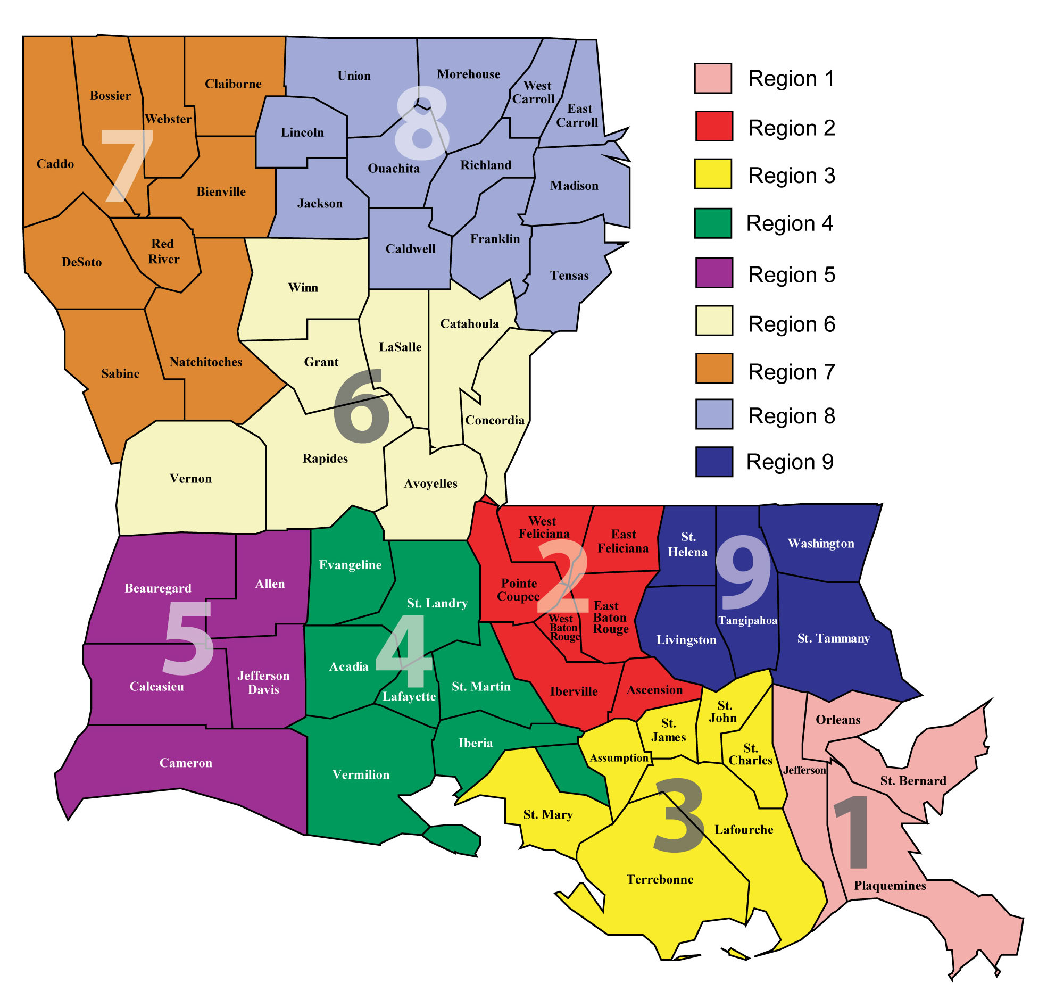
Program Outreach
Data-driven Outreach: Census data on rent-burdened households and level of applications and analysis of LERAP applicants
Network of community partners continues to grow
Completed initial series of virtual information sessions – nearly 500 attendees
Pilot applicant assistance event in Bienville Parish on Saturday, April 10
Targeted sessions for landlords underway; initial meeting in Alexandria on April 14
☒
☒
☒
☒
☒
☒
☒
☒
Indicates parish governments outside of state-administered program

Slide 9



Thank You
LAStateRent.com
Info@LAStateRent.com
877.459.6555

