Slide 1





LOUISIANA
HOUSING CORPORATION
Asset Management
Compliance & Construction
www.lhc.la.gov
LouisianaHousingCorp @lahousingcorp Louisiana-housing-corporation

Slide 2
Construction
The mission of the Construction Department is to verify, through review of construction documents and inspection of construction sites, that projects funded through LHC meet all contractual commitments made to LHC which are related to construction of the projects.
  Goals
      To verify that all projects approved for construction funding meet the requirements of the programs under which they are funded and that all agreements between LHC and the developers and/or owners, relative to construction, are fulfilled.
      To verify that all federal, state and local construction regulations, building and other applicable codes are followed.
      To report on construction progress and adherence to construction requirements of all projects under construction and after construction until placed in service.
www.lhc.la.gov
LouisianaHousingCorp @lahousingcorp Louisiana-housing-corporation

Slide 3
Construction Continued
In addition to Construction monitoring we perform HUD HQS, UPCS, UPCS-V and REAC inspections for internal and external clients.
BPI- QCI
Davis-Bacon
Environmental Review

Slide 4
2019-2021 Quarterly Inspections
2019 - 2071 Total Inspections
2021 – 2331 Inspections
Q1- 509 Inspections
Q2- 439 Inspections
Q3- 697 Inspections
Q4- 426 Inspections
2020- 2002 Total Inspections
Q1-429 Inspections
Q2-198 Inspections
Q3- 291 Inspections
Q4- 1084 Inspections
Q1- 1194 Inspections
Q2-1137 Inspections
Q3- TBD
Q4- TBD

Slide 5
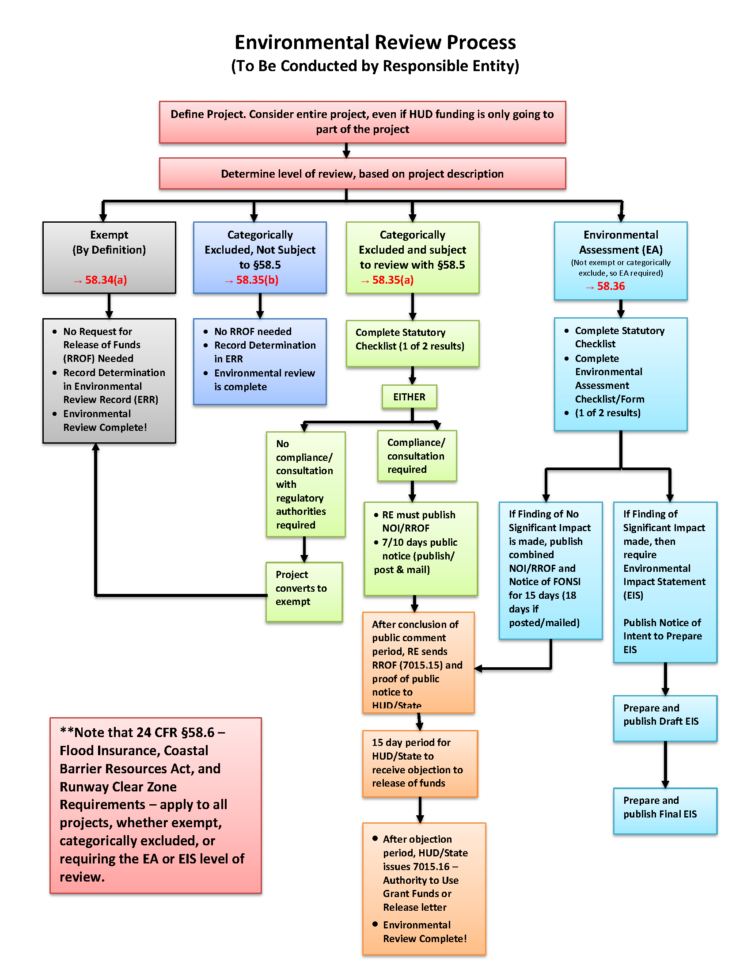

Slide 6
Compliance
The mission of the Compliance Department is to ensure, through desk audits and on-site inspections, that property owners and managers adhere to Federal, State and local laws governing program administration and compliance, and that they operate low-income rental housing programs professionally and efficiently.
A. Goals
1. To ensure that low-income housing properties are decent, safe, sanitary and well-maintained
2. To ensure that property owners and managers adhere to Regulatory Agreements, Compliance Monitoring Agreements & Fair Housing Laws
3. To maintain knowledge and awareness of current Congressional Legislation, Internal Revenue Service (IRS) laws and rulings, and HUD’s annual adjustments in Area Median Income calculations
4. To ensure that the housing policy objectives of Congress and HUD are met
5. To protect against fraud and misuse of funds
6. To ensure effective and efficient use of allocated funds
7. To ensure effective and efficient service delivery
8. To determine risk factors in order to set monitoring priorities
9. To identify and implement monitoring objectives for all programs, including:
a. Documenting program and compliance rules and adherence to the rules b. Identifying and tracking program and project results
c. Identifying innovative tools/techniques that support affordable housing goals
www.lhc.la.gov
LouisianaHousingCorp @lahousingcorp Louisiana-housing-corporation

Slide 7
Compliance & Construction
Compliance monitors projects in the LHC portfolio including:
  66 Piggyback
  45 1602
  10 FDIC
  8 NSP
  11 ARP
  253 HOME
  858 LIHTC
www.lhc.la.gov
LouisianaHousingCorp @lahousingcorp Louisiana-housing-corporation

Slide 8
Compliance Team Performance
In 2019 there were 457 different properties scheduled for review
  25,072 units total
  5011 units sampled
www.lhc.la.gov
LouisianaHousingCorp @lahousingcorp Louisiana-housing-corporation

