Slide 1
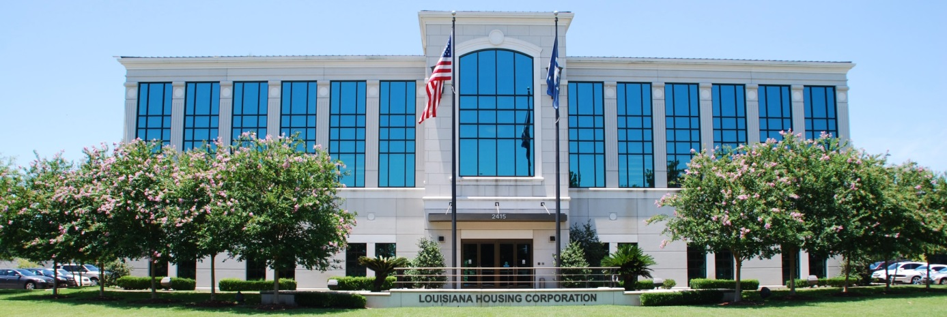




LOUISIANA
HOUSING CORPORATION
Disaster Recovery
www.lhc.la.gov
LouisianaHousingCorp @lahousingcorp Louisiana-housing-corporation

Slide 2
Disaster Recovery Staff

Slide 3
EBR Rebuilds Developer Program
Description of program
• Repair damaged rental housing stock that will be made available at affordable rental rates for low income households
• Increase the available rental stock in flood-damaged East Baton Rouge homes
  Initial Budget : $5,372,451.22
www.lhc.la.gov
LouisianaHousingCorp @lahousingcorp Louisiana-housing-corporation

Slide 4
2021 EBR Rebuilds Developers Program
Description of program
To repair damaged housing stock located within the City of Baton Rouge/East Baton Rouge Parish to be made available to interested parties at affordable rents for households at or below eighty percent (80%) of area median income.
To revitalize communities by eliminating the blight of vacant, dilapidated properties in order to increase the availability of quality
To leverage and encourage the use of private sector funding in concert with federally funded assistance to improve conditions of existing properties and/or bring properties back into commerce.
Initial Budget : $1,649,804.55
www.lhc.la.gov
LouisianaHousingCorp @lahousingcorp Louisiana-housing-corporation

Slide 5
Neighborhood Landlord Rental Property Program l, ll, lll
Description of programs
Provides assistance to landlord applicants experienced in renting residential properties to tenants or developing residential rental housing to be located in areas adversely affected by the 2016 severe storms and flooding events.
www.lhc.la.gov
LouisianaHousingCorp @lahousingcorp Louisiana-housing-corporation

Slide 6
Neighborhood Landlord Rental Property Program Phases l-lll Initial Budgets
    l - Initial Budget : $41,447,884.00
    ll - Initial Budget : $7,763,856.82
    lll – Anticipated Budget : $14,301,142.92
www.lhc.la.gov
LouisianaHousingCorp @lahousingcorp Louisiana-housing-corporation

Slide 7

Housing Preservation Grant
  Provides weatherization assistance to low and very low-income residents
  Eligible homeowners will receive $6,500 in funding that resides in the following parishes
      Ascension
      East Baton Rouge
      Iberville
      Livingston
      West Baton Rouge
  Initial Budget : $384,890
www.lhc.la.gov
LouisianaHousingCorp @lahousingcorp Louisiana-housing-corporation

