Slide 1






LOUISIANA
HOUSING CORPORATION
Organizational Performance and Reporting
www.lhc.la.gov
LouisianaHousingCorp @lahousingcorp Louisiana-housing-corporation

Slide 2


Mission Statement
Mission
The mission of the Organizational Performance and Reporting Team is to support LHCs mission-driven initiatives to ensure that Louisiana’s residents have access to safe, affordable, & energy efficient housing and related services by providing high level expertise in the development, management and improvement of key operational and strategic goals for the Louisiana Housing Corporation.
www.lhc.la.gov
LouisianaHousingCorp @lahousingcorp Louisiana-housing-corporation

Slide 3
Goal Statement
Primary Goal
The goal for this department is to develop performance measurement tools integrated with data strategies and technology to clearly report on the Corporation’s success and measure progress against its housing priorities and strategic plan.
www.lhc.la.gov
LouisianaHousingCorp @lahousingcorp Louisiana-housing-corporation

Slide 4

Core Lines of
Business
Process Improvement Plans
Specific areas of responsibility include developing process improvement plans that measure, assess, and improve the quality and efficiency of the housing programs and services provided by the Corporation.
Reporting and Graphic Design
Collaborate, design and support business units in their efforts to successfully meet the reporting needs of their departments.
Assessment & Data Validation
Performing Assessments on department data and validating data for accuracy prior to it being used for reporting.
www.lhc.la.gov
LouisianaHousingCorp @lahousingcorp Louisiana-housing-corporation

Slide 5
Strategic Planning
Another measure of Organizational Performance and Reporting is the function of developing agency Policy & Strategic Initiatives. A part of this function includes developing a strategic plan, inclusive of certain vital factors.
KEY COMPONENTS
• Program Research & Evaluation
• Tenant Surveys & Focus Groups
• Strategic Planning Committee
• Periodic Board Feedback
www.lhc.la.gov
LouisianaHousingCorp @lahousingcorp Louisiana-housing-corporation

Slide 6
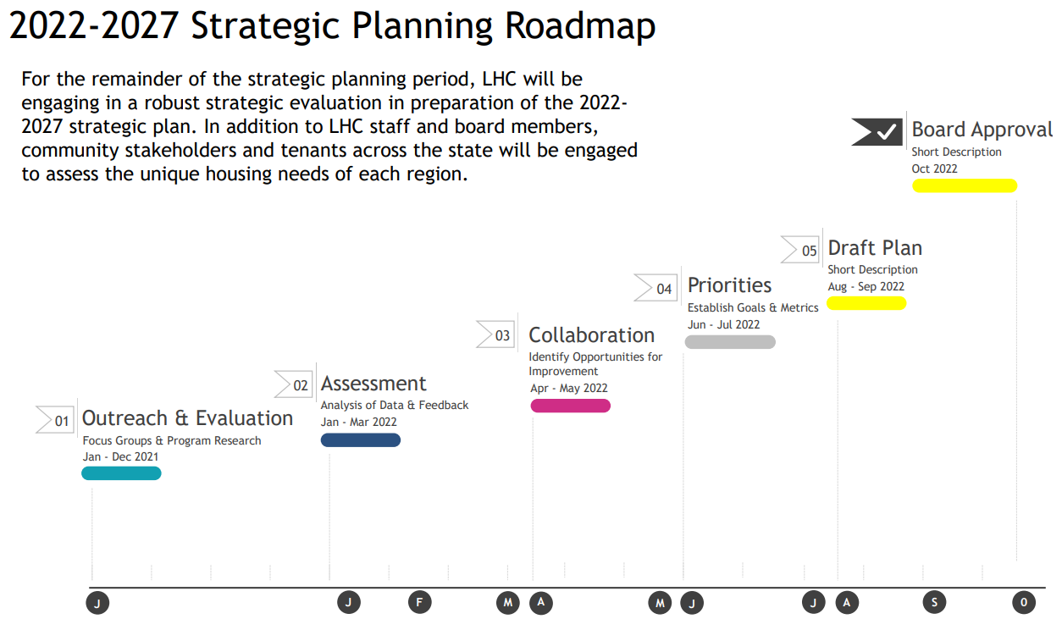
Strategic Planning Roadmap
www.lhc.la.gov
LouisianaHousingCorp @lahousingcorp Louisiana-housing-corporation

